Slide 1

FLIP
SIMON TATHAMS

Slide 2
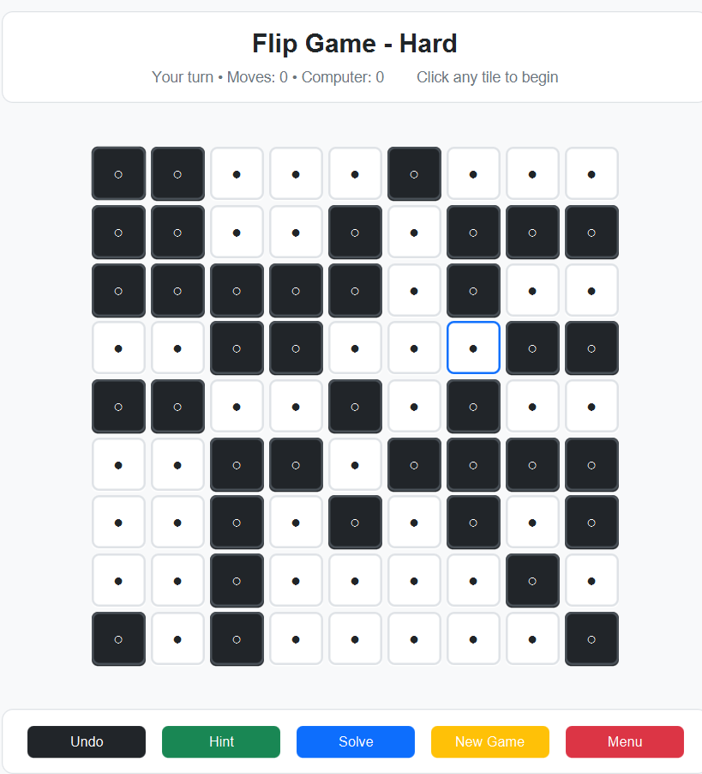
The Flip Game
A LOGIC PUZZLE INSPIRED BY SIMON TATHAMS
The Flip Game challenges players to turn all tiles on an N×N grid to the same state through strategic moves, utilizing a modern, interactive JavaFX interface for engaging gameplay.

Slide 3
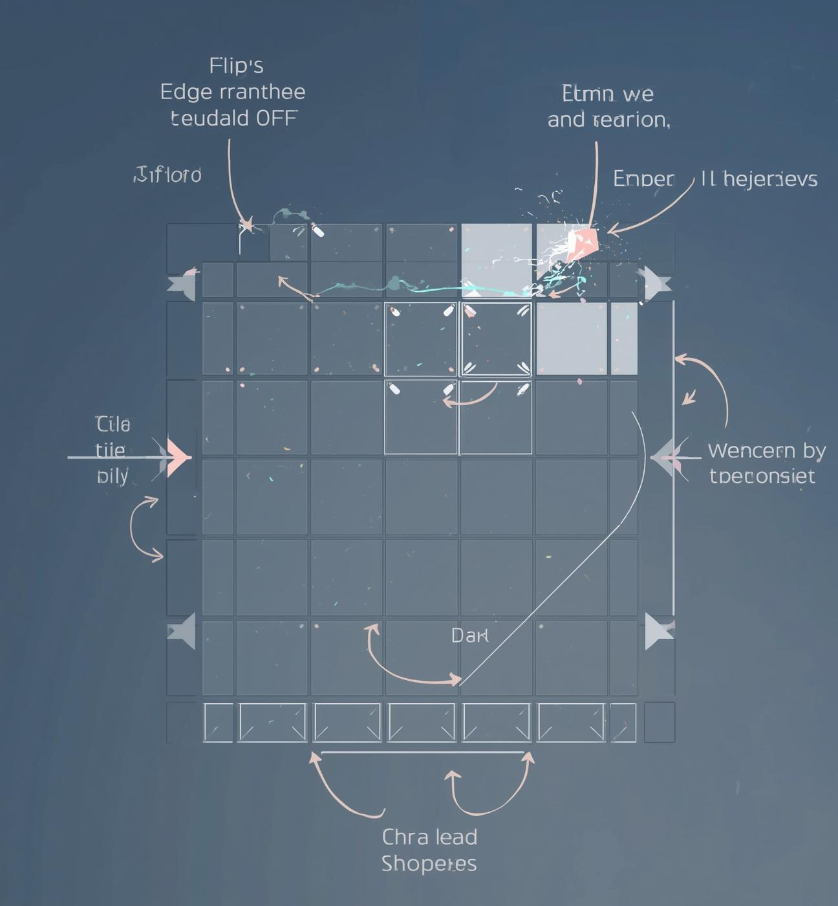
Game Difficulty and Enhancements

Slide 4
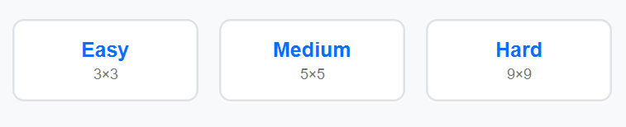
Game Difficulty
UNDERSTANDING THE FLIP GAME MECHANICS
4x4
6x6
10x10
Board Sizes
Tile States
Turn-Based Play
The Flip Game features three board sizes: Easy (4x4), Medium (6x6), and Hard (10x10). This variety caters to different skill levels and enhances player engagement.
Tiles have two possible states: ON (white) and OFF (black). Players aim to turn all tiles to the same state, adding a layer of strategy to the gameplay.
Gameplay alternates between the player and the computer. This turn-based system ensures strategic interactions, with the computer programmed to avoid making the last winning move.

Slide 5
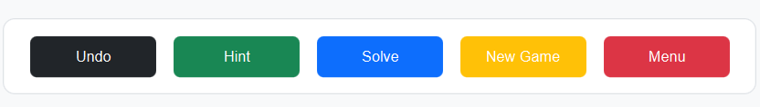
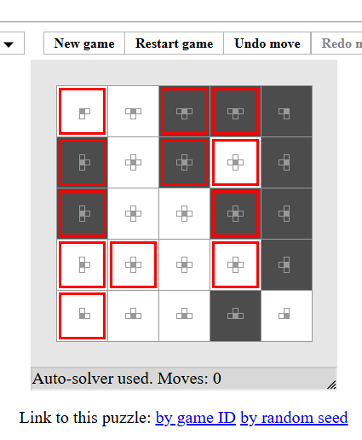
Game Enhancements
Undo
Players can revert to the previous state effortlessly.
Hint
Offers strategic guidance to assist players in decisions.
Auto-solve
Automatically completes the game for players when needed.

Slide 6
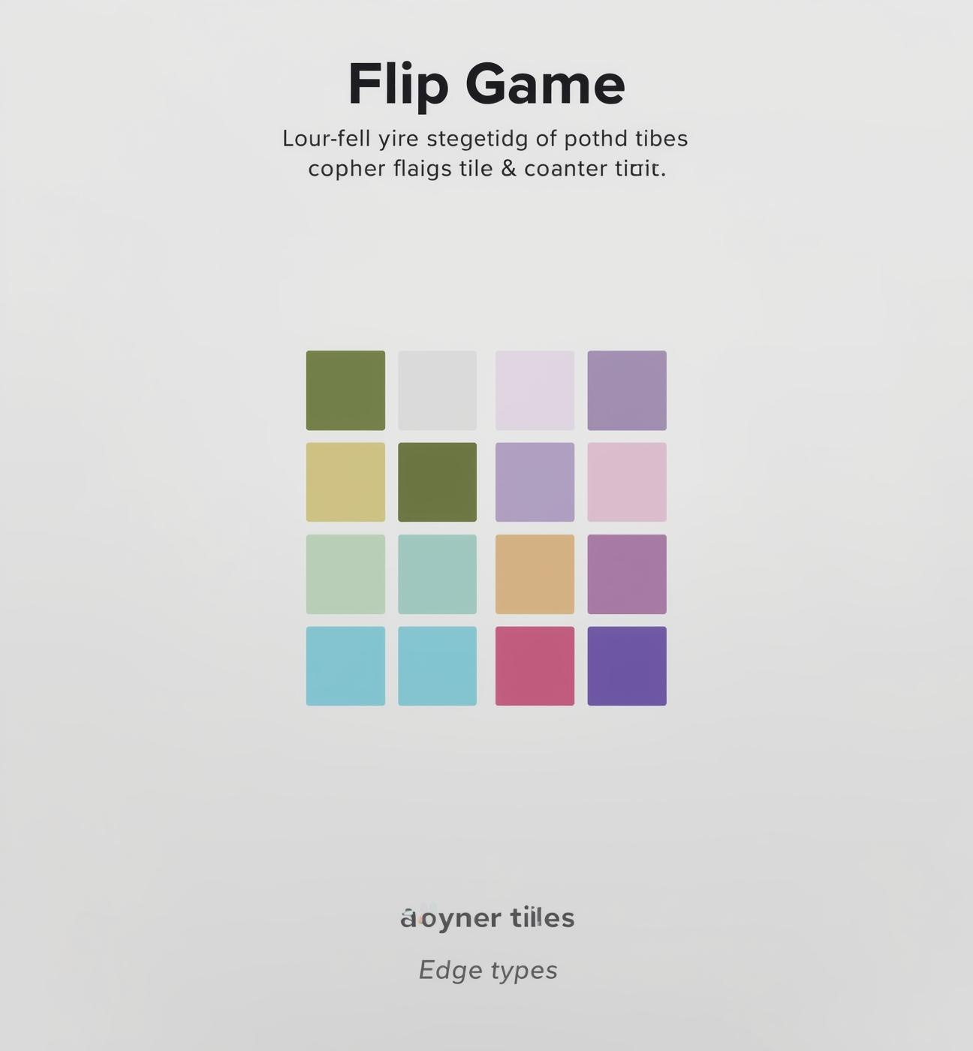
Tile Types and Graphs

Slide 7







Tile Types
UNDERSTANDING ADJACENCY PATTERNS FOR TILES
Corner Tiles
T-shape Tiles
Plus-shape Tiles
Corner tiles have two neighbors: adjacent tiles above and below or beside. Their flipping behavior affects nearby tiles, making them critical in determining overall game strategy.
Edge tiles feature three neighbors surrounding them. This positioning influences the flipping mechanics, requiring strategic consideration when planning tile interactions during gameplay.
Center tiles boast four neighbors which provide them with the most impact. Their connections to surrounding tiles allow for greater influence on the board's overall state during moves.

Slide 8
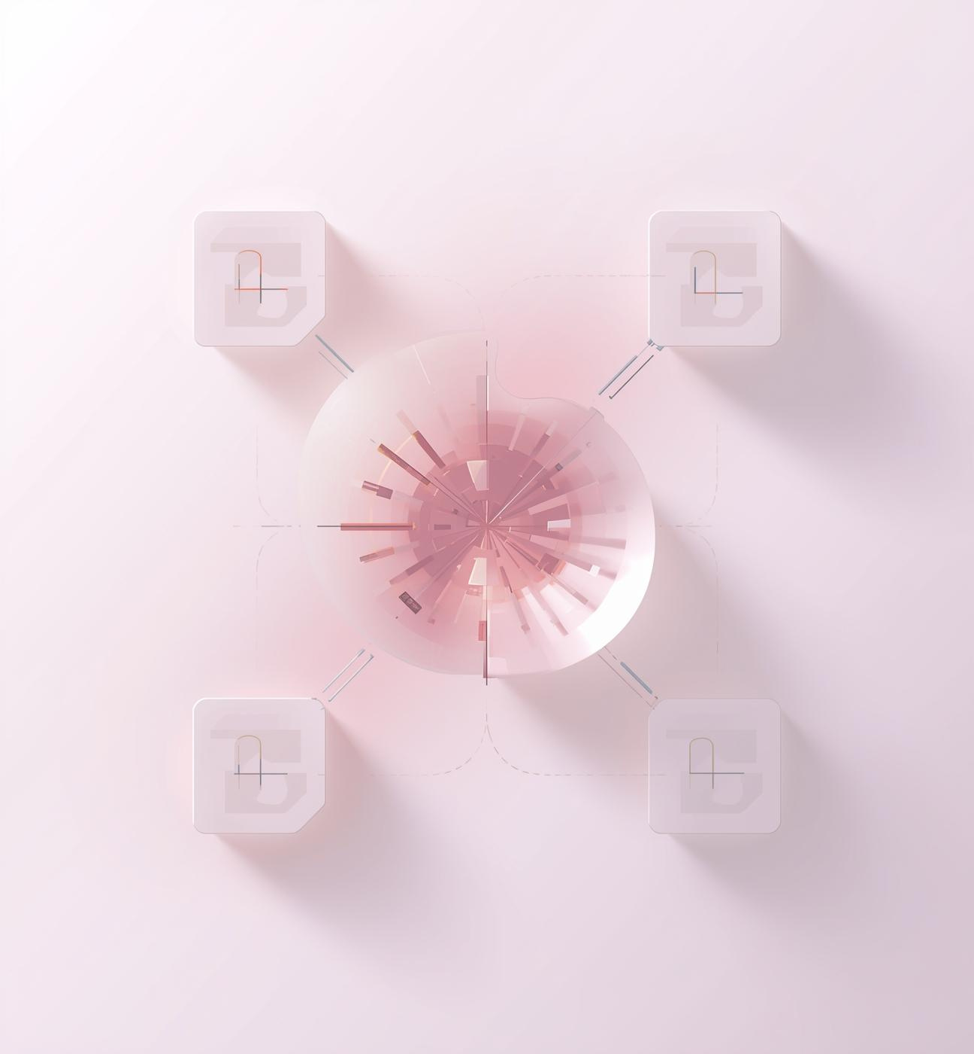
Divide and Conquer

Slide 9
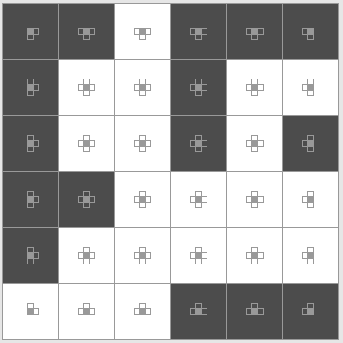
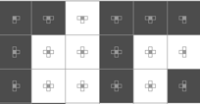

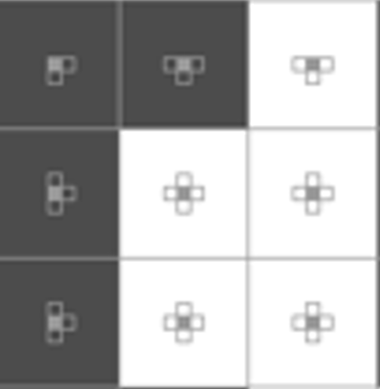



Divide and Conquer
Dividing the Board into smaller sub problems
The large 𝑁×𝑁board is first divided into two horizontal halves, and then Each half is then further divided into two smaller square regions of size (N/2)×(𝑁/2)
This hierarchical division breaks the large problem into smaller and manageable subproblems.
Each small region is solved independently using an exact solving method.
Finally, all partial solutions are merged together to obtain the solution for the entire board.

Slide 10
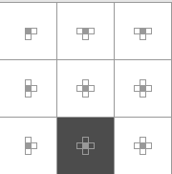
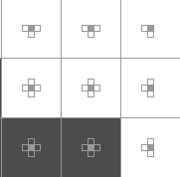
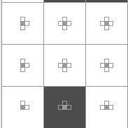
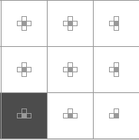
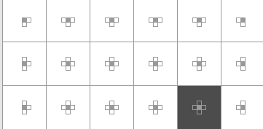
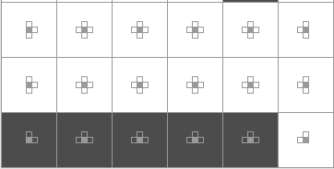
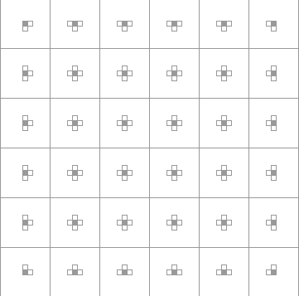
Divide and Conquer
Solve each sub-region independently.
Use first-row enumeration.
Apply chase-down strategy.
Verify correctness before applying moves.

Slide 11

Chase-Down Strategy

Slide 12
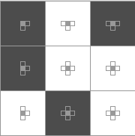
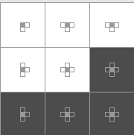
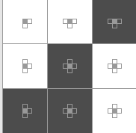
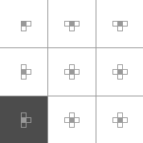
How chase-down works?
After selecting a flip pattern for the first row, the remaining rows are solved using the chase-down method.
If any cell in the previous row is black (0), we must flip the cell directly below it.
This forces the previous row to become white.
By repeating this process row by row, all black cells are pushed downward and eliminated.
At the end, if the last row is completely white, the solution is valid.

Slide 13
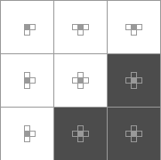
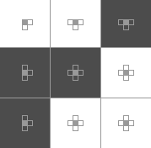
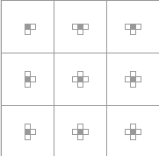
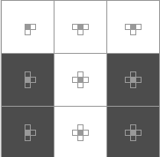
How the Last Row is Solved?
  After applying the chase-down strategy, all rows except the last row are forced to become white.
  At this stage:
      The last row depends completely on the first-row choices.
      We cannot flip below the last row, so we must verify correctness.
  If the entire last row is white, the solution is valid.
  If any black cell remains, the chosen first-row pattern is discarded, and we try a new pattern.

Slide 14
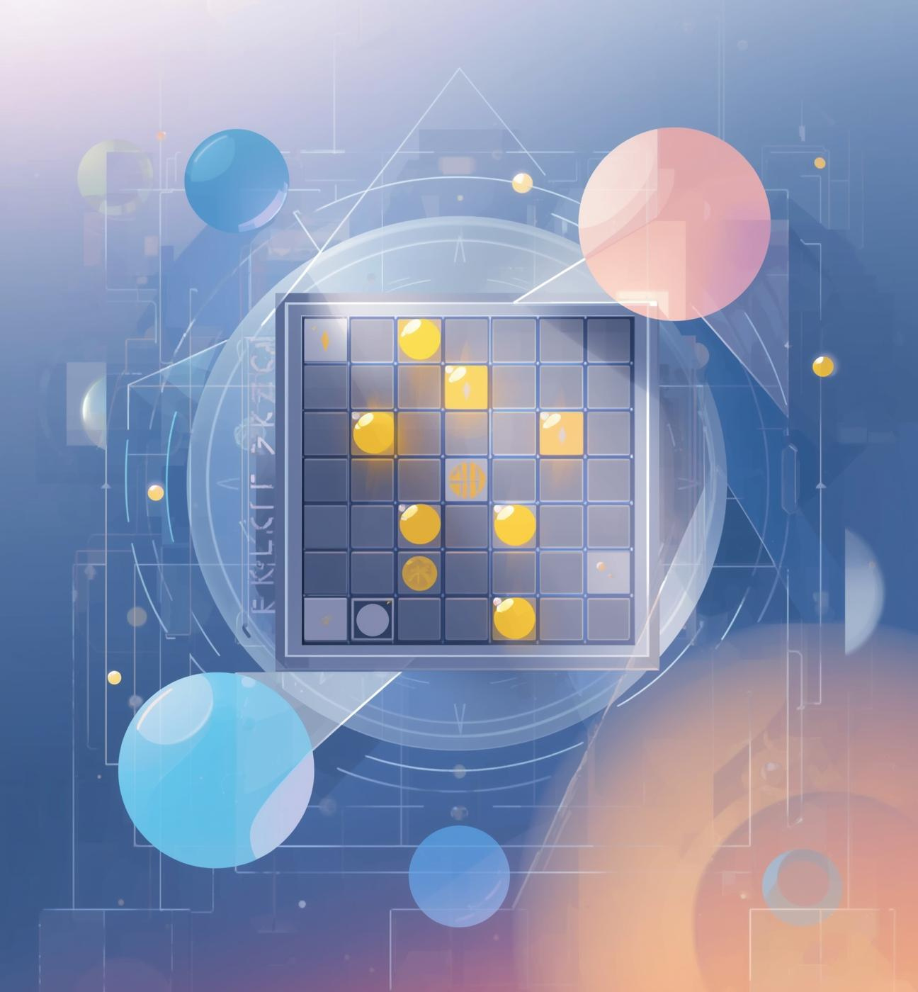
Computer Move Integration

Slide 15
Computer Helper
ENHANCING USER EXPERIENCE WITH INTELLIGENT MOVES
Subproblem Strategy
Animation Effects
Undo Stack
The board is divided into structured regions.
The algorithm solves smaller subproblems first:
Each region is solved independently using the chase-down technique.
This reduces search space and ensures systematic solving.
Computer moves are animated with highlights and delays, creating a dynamic visual experience that engages players and enhances the overall interaction with the game.
An undo stack allows players to reverse their previous moves, providing flexibility in gameplay and enabling them to strategize effectively without the fear of irreversible mistakes.

Slide 16

Performance and Complexity Analysis

Slide 17
Complexity Analysis
TIME AND SPACE CONSIDERATIONS
Board Operations
Chase-Down
Board operations maintain a complexity of O(n²), ensuring efficient processing as the grid size increases, allowing for manageable gameplay dynamics.
Top row has N cells, each can be:
Flip (1)
Not flip (0)
So total possibilities: 2^N
O(2^n)

Slide 18
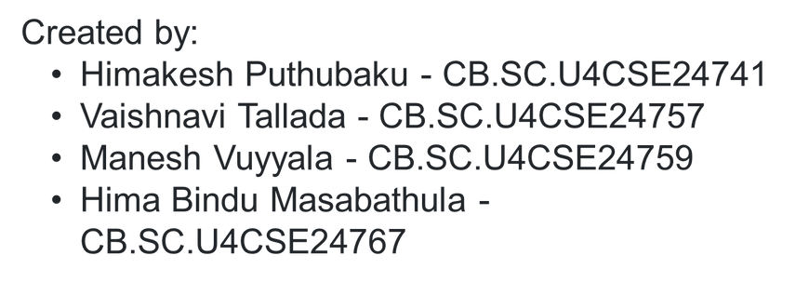
Thank You!

